Slide 1

BADI Drug Regulatory Affairs e-Congress
The UNICOM Project – benefits from ISO IDMP/SPOR for health care professionals and patients
Peter Bachmann

Slide 2
There is one central question
If I have a prescription for medicine ‘Bonn‘ and
  there is a shortage of this specific brand
  I‘m travelling in the EU/EEA (or the world)
  …
how could someone
  identify my medicine ‘Bonn‘
  subsitute my medicine ‘Bonn‘ with the equivalent medicine ‘Sofia‘
and make my happy?

Slide 3
How to identify a medicinal product in a unic way ?

Slide 4
How to identify a medicinal product?
name of the medicinal product
the active substance/moiety (valsartan / валсартан)
the strength
the pharmaceutical form
or by a unic number

Slide 5
… and what is comparable
5 mg tablet / 10 mg tablet
5 mg tablet / 10 mg tablet with a breakline
(strength of the product vs. administrable strength)
tablet /capsule / sacchet / oral solution / …
…
What do we need?
Standards and Masterdata

Slide 6
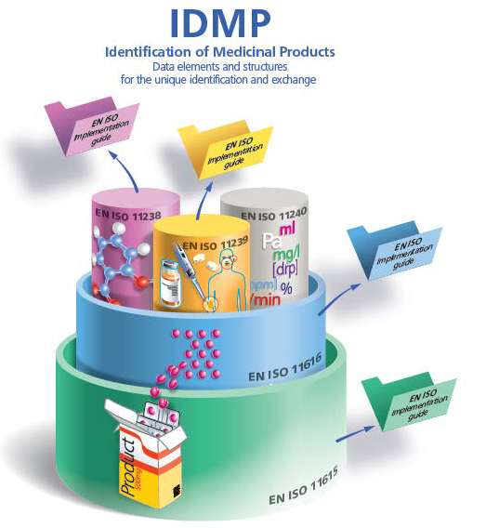
ISO IDMP Suite of Standards
The ISO IDMP standards establish definitions and concepts and describe data elements and their structural relationships that are required for the unique identification of:
Medicinal products (MPID) and packages (PCID) - ISO 11615
Pharmaceutical products (PhPID) - ISO 11616
Substances (Substance ID) - ISO 11238
Pharmaceutical dose forms, units of presentation, routes of administration and packaging - ISO 11239
Units of measurement (UCUM) - ISO 11240
ISO IDMP standards apply to both authorised and developmental medicinal products for human use
© Christian Hay

Slide 7
Response to Regulatory Requirements
Implementing Regulation (EU) No 520/2012 on “the performance of pharmacovigilance activities”
states that “terminology set out in the ISO IDMP suite of standards” is binding for “Member States, marketing authorisation holders and the [European Medicines] Agency.”
specifies this as “internationally agreed terminology” applied “for … electronic exchange and communication of pharmacovigilance and medicinal product information.”

Slide 8
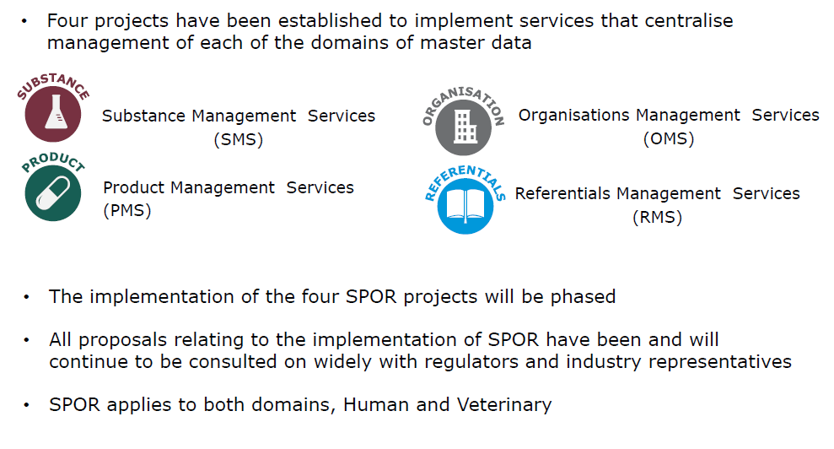
Implementing ISO IDMP through SPOR

Slide 9
Some facts and questions
the authorisation of medicinal products delivers the basic set of informations about a medicinal product (active substance, composition, indication, contraindication, populations, …) to be used in a health care system
structured data about a medicinal product from (clinical trial) application to the deletion of the MA is crucial
How to provide the (end)user with this information?
How to keep the quality of the data at a high level during the life cycle?
Is a name of a substance (= SMS) sufficient to characterise a substance?
…

Slide 10
European Innovation Action – Goals, Context, Challenges

Slide 11
Vision & Mission
Vision
Improving patient safety
Facilitating better healthcare for all
Mission
Enabling the univocal identification of medicinal products by supporting and accelerating the
  further development,
  implementation, and
  diffusion of ISO IDMP standards (IDentification of Medicinal and pharmaceutical Products)
across European health systems, to
facilitate the free flow of semantically coded interoperable medicinal product information

Slide 12
UNICOM - Overview
This HORIZON2020 innovation action will give a powerful impulse to the implementation of ISO IDMP standards in EU Member States drug databases, supporting safe cross-border ePrescription/eDispensation and effective pharmacovigilance.
Once EU-interoperable data on medicines taken by patients become available, further benefits will accrue through better health data for improved clinical decision support, patient empowerment, public health and clinical research. New opportunities will arise for pharma industry, software developers, SMEs providing smart apps and others, thereby fostering their innovation capacity and competitiveness.
Project ambition centres on conversion of key regulatory and clinical processes to use IDMP. These information value chains must be converted over their full length from data input to data repositories to data usage. Project work spans all three areas, focussing on the most challenging, the implementation of EU and national SPOR compatible (substances, products, organisations, referentials) data bases, including establishing an EU Substance Reference System (EU-SRS). Such information is fundamental to cross-border ePrescription where safe dispensation may require reliable identification of substances in available products.
19 countries are represented
26 national Drug and eHealth Agencies
Stakeholders are involved through their associations
duration is 4 years (Dec. 2019 – Nov. 2023)
budget € 21 m, with requested funding € 19 m.

Slide 13
Application Domains and Objectives
By accelerating the diffusion of ISO IDMP standards UNICOM supports
regulatory processes of National Medicines Authorities (NMAs) & the European Medicines Agency (EMA)
cross-border digital health services (ePrescription, Patient Summary)
global pharmacovigilance
better healthcare, public health, medical research (e.g. Big Data Analytics, Artificial Intelligence applications)
Core objectives focus on:
Adaptation and implementation of IDMP at NMA/EU levels
Adaptation of Member States cross-border digital health services (ePrescription; Patient Summary…) to IDMP
Exploration and implementation of IDMP for pharmacovigilance reporting, Medicinal Product Dictionaries (MPDs), digital health support services, patient empowerment

Slide 14
UNICOM Action Lines
To achieve the objectives envisaged and reach the outcomes foreseen, UNICOM is organised along three closely interrelated vertical action lines:
  Implementation of IDMP at national and EU level (WPs 2 – 4)
  Adaptation of cross-border digital health services (WPs 5 – 7)
  Exploration for pharmacovigilance services, Medicinal Product Dictionaries [MPDs], healthcare services, patient empowerment, Big Data etc. (WPs 8 – 9)
These three action lines are supported by two horizontal activity clusters:
a) Further development of IDMP standards and implementation support (WP 1)
b) Socio-economic impact assessment and sustainability strategies, scientific coordination, project management, awareness raising/dissemination, ethics (WPs
10 – 13)

Slide 15
Core UNICOM activities by National Medicines Authorities (NMAs)
Action Line I: Implementation of IDMP at national and EU level

Slide 16
WP2: EU Substance Registration System (EU-SRS)
Implementation of EU-SRS
  EU regulatory-network-wide accessible, structured database
  unambiguous identification of substances in medicinal products based on their scientific properties
  in accordance with ISO IDMP standard 11238 (Substance IDs) and ISO standard 19844 (Implementation guidelines for ISO 11238 for data elements and structures)
Heads of Medicines Agencies (HMA) endorsed implementation plan (first phase ready by 2021/22)
Will be linked with EMA SPOR (substances, products, organisations, referentials) IDMP-compatible databank system, particularly SMS [Substance Management System])

Slide 17
Roadmap EU-SRS Implementation
HMA Endorsement
EU-SRS implementation
Go-live
EU-SRS
Report to HMA
Report to HMA
Phase 1 execution EU-SRS implementation
Interim evaluation & report
Phase 2 execution EU-SRS implementation
Hand-over to EMA
Mar 2020
Mar 2021
Jun 2021
Mid 2022
Phase 1:
Continue data cleansing (chemicals, proteins, vaccines, polymers (H+V))
Q2/2020: Installation EU-SRS (GSRS version 2.5.1) – used for cleansing of e.g. vaccines
Q4/2020: Installation & validation EU-SRS (GSRS version 3.0)
Q1/2021: Load cleansed data into EU-SRS
Q1/2021: Go live EU-SRS for use by EU Regulatory Network
Training, Substance Management Process & Governance, discuss veterinary substance management

Slide 18











Onboarding Team: Substance Validation Group (SVG)
Organization | #SVG members | Country
NoMA | 1 | Norway
EMA | 2 | Europe
MPA | 1 | Sweden
AEMPS | 2 | Spain
MEB | Chair, 3H, 1V | Netherlands
SUKL | 1 | Czech Republic
BfArM | 2 | Germany
Ages | 2 | Austria
JAZMP | 1 | Slovenia
WHO-UMC | 1 | World
ANSES | 1V | France

Slide 19
WP 3: IDMP compliant ‘Application Forms’ (CESP)
Applying for authorisation of medicinal products & managing their life cycles
Electronic tools and forms compliant with IDMP
IDMP compliant electronic tools supporting
  Initial application
  Variation
  Renewal activities
Replace the legacy PDF-technology based application forms with the web-based CESP Dataset Module
Integration with EMA’s SPOR services
Ensure well-structured IDMP compliant interoperable drug information for all further processes and actors

Slide 20
UNICOM WP 3 in short
Applying for authorisations for medicinal products and managing their life cycles is a regulated process supported by electronic application forms and supporting electronic tools.
At the moment neither application forms nor the tools for initial authorisations, variations and renewals are compliant to the IDMP standards.
Thus it is currently not possible to start, automate and feed regulatory processes with IDMP compliant/structured data and easily re-use the data in EU-wide eHealth services.
Providing application forms based on IDMP-standards enables harmonised structured data for all following consumers and processes.
7 National competent authorities work together in this WP to refactor the application forms plus tools towards IDMP
  Austria, Spain, Netherlands, Germany, Ireland, Sweden, Norway
This WP will be aligned with a planned EMA/HMA telematics project called “CESP Phase 2” which will utilize the results and implement the outcomes in the regulatory network.

Slide 21
WP 4: IDMP Implementation at National Medicines Authorities
11 national implementation projects
Austria, Belgium, Croatia, Estonia, Finland, Germany, Ireland, Norway, Portugal, Spain, Sweden, (The Netherlands)
Development of guidelines, training and knowledge about IDMP
Adaptation of the European Communication and Tracking System (CTS)
  Used for tracking and co-ordinating pre- and post-licensing regulatory processes
  for human and veterinary medicinal products
  authorised via mutual recognition and decentralised procedures

Slide 22
IDMP and European crossBorder digital health services (ePrescription; Patient Summary)
Action Line II: Adaptation of cross-border digital health services

Slide 23
Use Case: xBorder ePrescription & dispensation process
Common level is
Country A
usually
pharma
-
Country B
ceutical product,
i.e. substitution or
selection required
Pharmaceutical
Product
PhP
Product is further
Same
specified, thanks to
medicinal
standardised
attributes
product (if
available)
Medicinal
MP
Product
Product is specified
at any of the IDMP
levels
in an ePrescription
Package
PC

Slide 24
Changes foreseen on EU eHealth Digital Services Infrastructure (eHDSI)
Functional specifications revised to include the adoption of ISO IDMP
  Revision of the CEF eHDSI Master ValueSet Catalogue (MVC) for the ValueSets affected by the adoption of ISO IDMP coding
Guidelines and recommendations for implementation of eP / eD and PS processes
The Implementation Guides of eP/eD and PS are used by Member States to implement the HL7 CDA documents and by the CEF eHDSI Solution Provider
Relevant CEF eHDSI Change Proposals will be drafted and submitted to the CEF eHDSI
  These Change Proposals will address technical specifications and the OpenNCP components and functionalities

Slide 25
Can we re-use data/aligned with other projects in the pipeline/on the horizon?

Slide 26
Electronic Product Information (ePI) for EU medicines

Slide 27
ePI key principles
1
ePI and EU common standard definitions
Expansion of access to information on medicines
Accessibility to users with diverse abilities
Creation of efficiencies in administration of regulatory procedures
Complementarity to paper package leaflet
2
3
4
5

Slide 28
ePI key principles
6
Open access to regulator-approved information
Data protection
Flexibility in implementation
Support for multilingual PI
Interoperability with EU and global initiatives
7
8
9
10

Slide 29
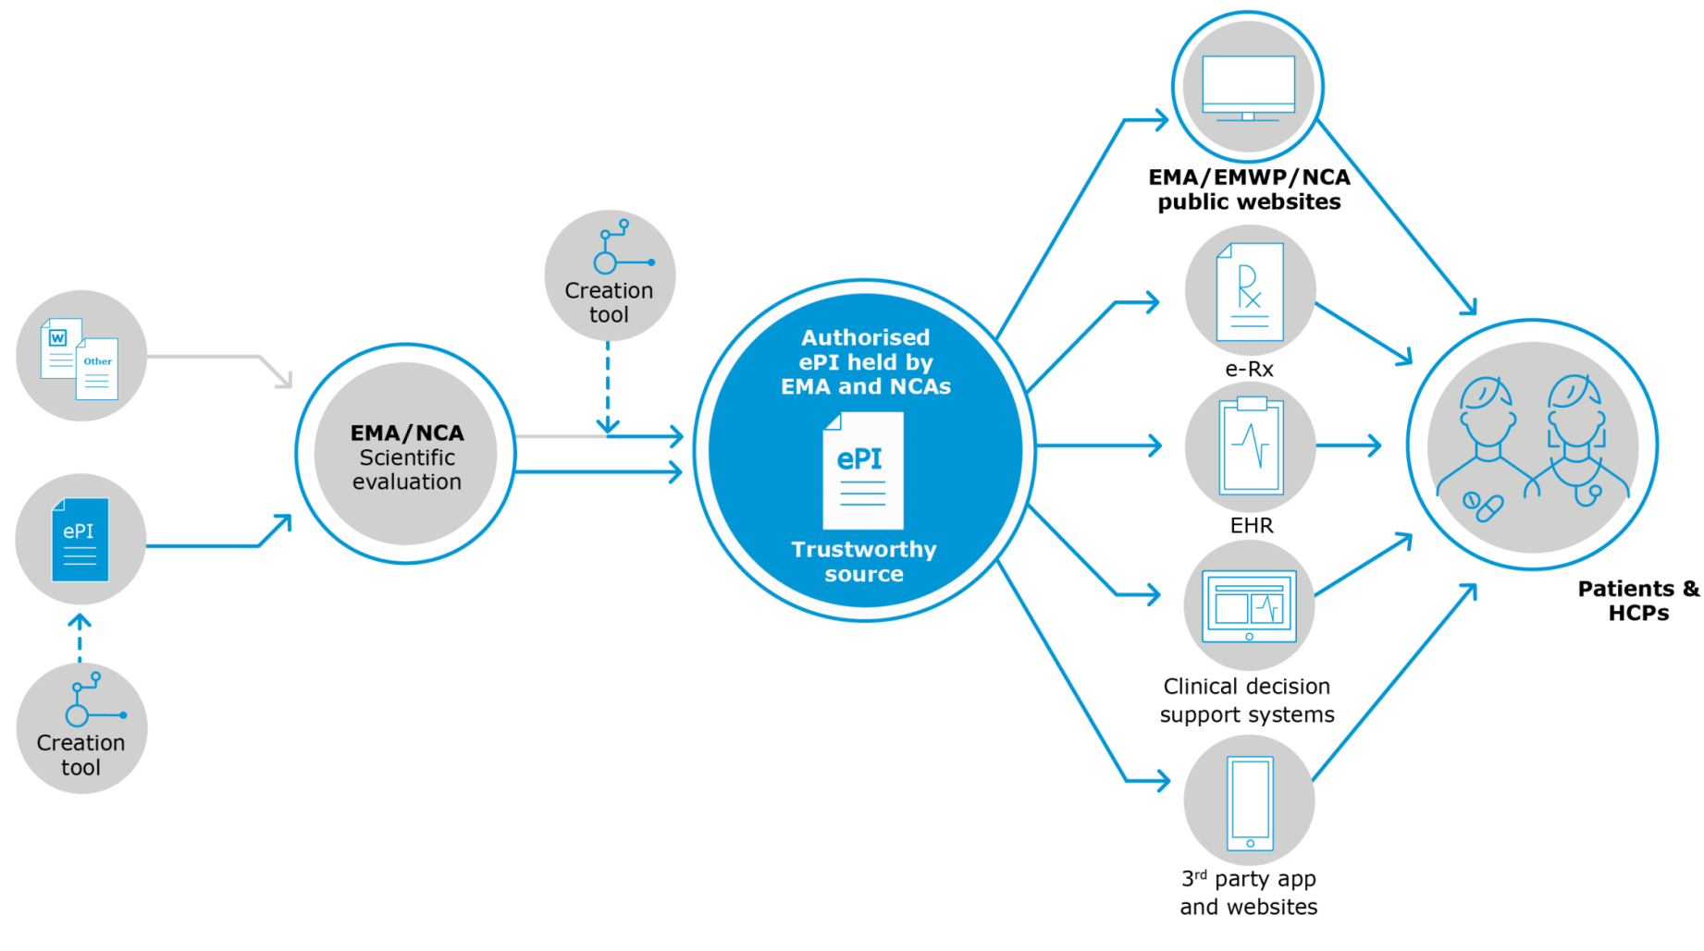
ePI key principles

Slide 30
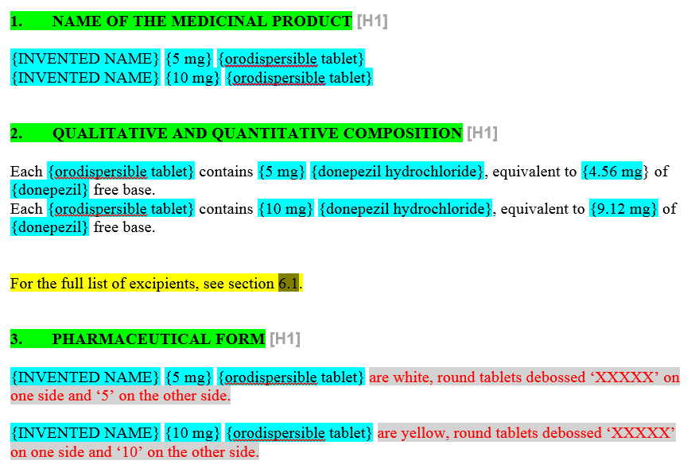
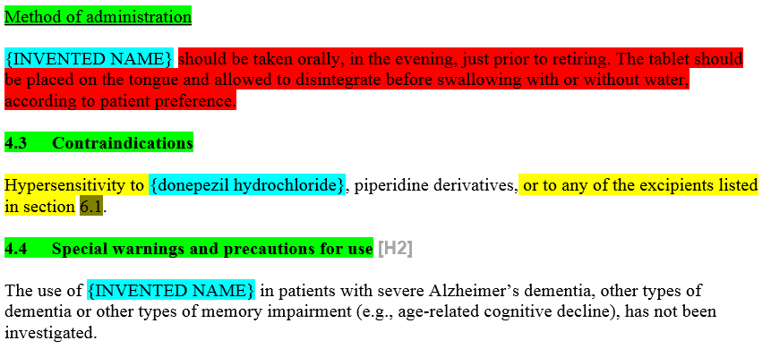
ePI-Templates – how it could look like?
    They are based on the existing templates (QRD) for the ‘paper-version’

Slide 31
Conclusions:
eAF (and future CESP) is the carrier for the data entry in regulatory processes
PMS is the product master data used for regulatory processes (master data is the data that it is submitted once and reused multiple times)
ePI is the statutory product information, as authorised during the regulatory processes.

Slide 32
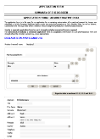






CESP Dataset? This is UNICOM WP 3!
CESP Application Dataset Management Module
Electronic data format
for automated data import
creates
Human readable
application data
manual data entry /update
“Dataset”
Draft cover letter,
Draft EMA formatted table template
CESP delivery file
integrates
IT supported data upload anticipated
SPOR
?
applicant level

Slide 33
… and many thanks to
      Georg Neuwirther (AGES)
      HMA WG ‘Better use of Medicines’
      ePI Roadmap WG
      EMA
      UNICOM
      and the other usual suspects

