Slide 1
IDMP medication substitution game
Please open this slide-deck in presentation mode to start the game

Slide 2
Global Medication Crisis Alert!
As a dedicated physician, you're facing a challenging reality: a worldwide shortage of essential medications. In your office sits a patient, anxious and in need. She's dependent on a medication that's now scarce. It's up to you to navigate through limited resources and uncover a viable substitute.
Mission: Find the Right Alternative
Can you secure her health with a successful substitution? Time to make critical decisions, doctor. The health of your patient rests in your hands. Choose wisely!

Slide 3
Vitaflexin
Vitaflexin is formulated with the active substance Flexirilin, available as oral capsules. Each capsule contains 150 mg of Flexirilin. This medication is specifically designed for the management of acute muscular spasms. Dosage form: capsule. Strength: 150 mg per capsule. Route of administration: oral. Recommended usage is to take one capsule every eight hours or as prescribed by a healthcare professional.
Flexinova
Flexinova contains the active substance Tryptalinium, available as oral capsules. Each capsule contains 100 mg of Tryptalinium. This formulation is designed for the management of acute migraine attacks. Dosage form: capsule. Strength: 100 mg per capsule. Route of administration: oral. Patients should take one capsule at the onset of migraine symptoms or as prescribed
Vitamaxin
Vitamaxin comprises the active substance Maxitropin, available as oral tablets. Each tablet delivers 150 mg of Maxitropin. This medication is designed for enhancing immune system response. Dosage form: tablet. Strength: 150 mg per tablet. Route of administration: oral. It is recommended for adults to take one tablet three times a day with meals or as advised by a healthcare provider.
Vitaplexol
Vitaplexol features the active ingredient Tryptazol, available as oral capsules. Each capsule contains 250 mg of Tryptazol. This medication is indicated for the treatment of acute anxiety disorders. Dosage form: capsule. Strength: 250 mg per capsule. Route of administration: oral. The suggested dosage is one capsule daily, preferably in the morning, or as directed by a healthcare provider.
Maxicosi
Maxicosi is composed of the active ingredient Ronixafin, available as oral suspension. Each 5 mL of the suspension contains 50 mg of Ronixafin. This medication is used for the rapid relief of allergic symptoms. Dosage form: suspension. Strength: 50 mg per 5 mL. Route of administration: oral. Recommended dosage is 5 mL taken twice daily, or as prescribed by a healthcare professional.
Help find the exact same substitute for the medicine listed below
Vitacurex
Vitacurex contains the active substance Tryptalinium, available as oral tablets. Each tablet contains 100 mg of Tryptalinium. This medication is indicated for the treatment of severe chronic pain. Dosage form: tablet. Strength: 100 mg per tablet. Route of administration(RoA): oral. Patients are advised to take one tablet twice daily or as directed by their healthcare provider.
Click here to continue
Correct!
Relievon
Relievon features the active ingredient Tryptalinium, formulated as oral tablets. Each tablet delivers a 100 mg dose of Tryptalinium. The medication is prescribed for managing severe chronic pain. Dosage form: tablet. Strength: 100 mg per tablet. Route of administration: oral. Recommended dosage is one tablet taken twice daily or according to physician guidance.
Zekesherald
Zekesherald contains the active substance Zenolapril, available in the form of oral capsules. Each capsule includes 75 mg of Zenolapril. This medication is primarily prescribed for managing hypertension. Dosage form: capsule. Strength: 75 mg per capsule. Route of administration: oral. The typical dosage is one capsule once daily, ideally in the morning, or as directed by a healthcare provider.
Maxirelax
Maxirelax features the active ingredient Relaxotride, available as oral tablets. Each tablet contains 120 mg of Relaxotride. This medication is designed for the treatment of muscle spasms and associated pain. Dosage form: tablet. Strength: 120 mg per tablet. Route of administration: oral. Recommended dosage is one tablet three times a day, or as advised by a healthcare provider.
Vitacalmin
Vitacalmin is formulated with the active ingredient Calmitrine, provided as oral tablets. Each tablet contains 120 mg of Calmitrine. This medication is intended for the treatment of moderate to severe muscle spasms. Dosage form: tablet. Strength: 120 mg per tablet. Route of administration: oral. Patients are advised to take one tablet three times daily, or as prescribed by their healthcare provider.
Vitacurin
Vitacurin features the active ingredient Tryptanil, available as oral capsules. Each capsule contains 100 mg of Tryptanil. This medication is indicated for the treatment of neuropathic pain. Dosage form: capsule. Strength: 100 mg per capsule. Route of administration: oral. Recommended dosage is one capsule twice daily, or as directed by a healthcare provider.

Slide 4
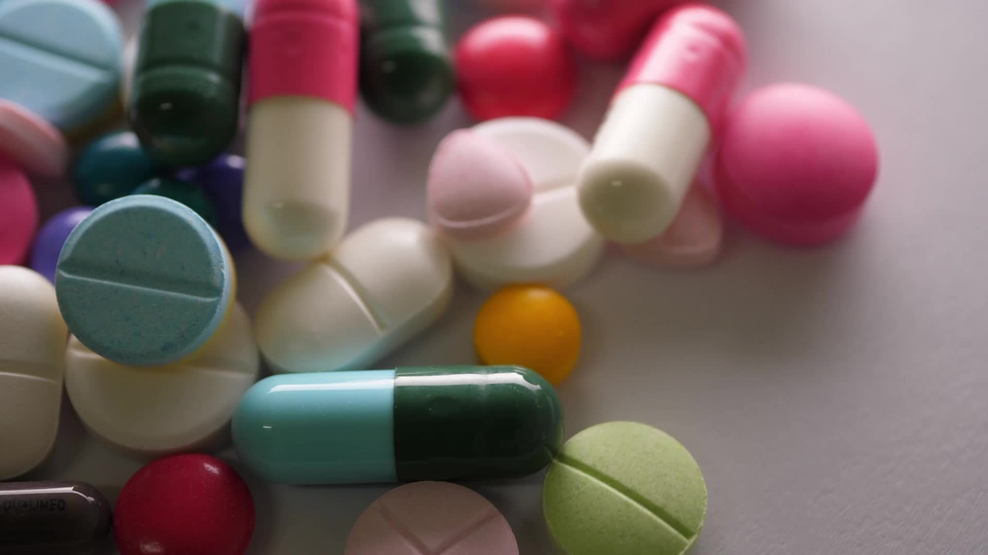
That was a very hard find! Healthcare heroes, to aid you in the quest for medication alternatives, we've harnessed the power of IDMP standards. These mystical tools will structure and define our medication data with unparalleled precision.
Quest Objective: Make Informed Decisions Faster
Let's put these powerful standards to the test. Will they help you make quicker, better-informed choices? Gear up, and let's discover the impact together in this critical mission!

Slide 5
HealthGuardian
Active substance: Chloroquine Phosphate
Strength: 30mg/ml Dose form: Solution
RoA: Ocular
Plaquenil
Active substance:
Chlorpheniramine maleate
Strength: 50mg/ml
Dose form: Solution
RoA: Ocular
Αγάπη
Active substance: Chlorpromazine sulfate
Strength: 500mg Dose form: Tablet
RoA: Oral
A-CQ 100
Active substance:
Chlorhexidine Gluconate
Strength: 250mg Dose form: Capsule
RoA: Oral
Vitalaquin
Active substance: Chlorpromazine sulfate
Strength: 500mg Dose form: Suppository
RoA: Rectal
There is a better option!
Help find the exact same substitute for the medicine listed below
Erasmiology
Active substance:
Chloroquine Phosphate
Strength: 300mg
Dose form: Tablet
RoA: Oral
Click here to continue
Correct!
Topicaulity
Active substance: Chlorpromazine sulfate
Strength: 300mg Dose form: Suppository
RoA: Rectal
Avloclor
Active substance: Chloroquine Phosphate
Strength: 300mg Dose form: Tablet
RoA: Oral
Μεταφράζω
Active substance:
Chlorpheniramine maleate
Strength: 80mg/ml
Dose form: Solution
RoA: Ocular
Supposifloring
Active substance: Chlortetracycline Hydroxychloride
Strength: 300mg Dose form: Tablets
RoA: Oral
QunataRelief
Active substance:
Chlorhexidine Gluconate
Strength: 400mg Dose form: Capsule
RoA: Oral

Slide 6
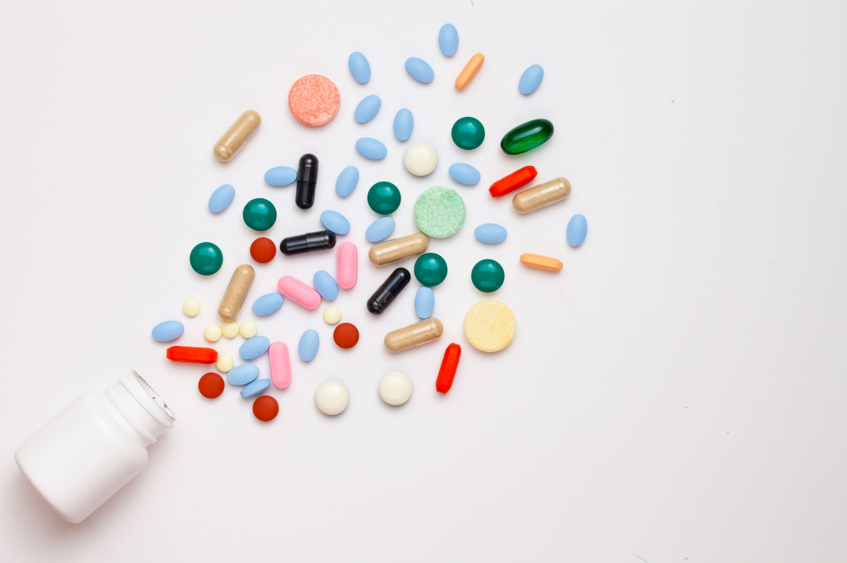
That went a lot faster, which means more time and personal contact with your patient!
And did you notice you were a lot less hesitant and in doubt about the correct answer? Standardising data already helps organise the data a lot!
But now let’s try to move away from standardising for regulatory purposes and try to present the data from a clinical perspective

Slide 7
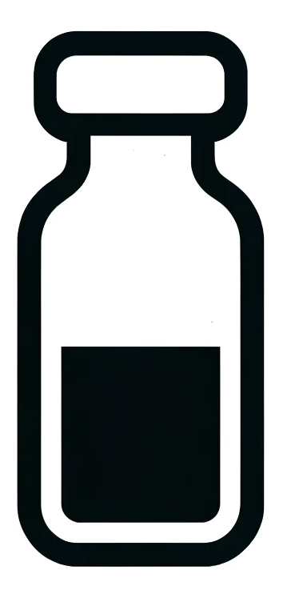
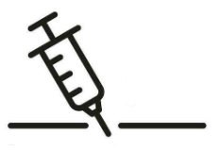
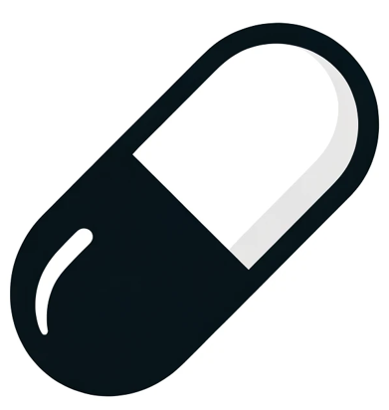
There is a better option!
There is a better option!
Correct!
Correct!
Curalix
Medinova
Θεραπεία
Remedix
Allevion
Help find the exact same substitute for the medicine listed below
Vitalumina
300mg
30mg/ml
80mg/ml
300mg
300mg
Click here to continue
Click here to continue
Synthacure
Ιατρική
Healixir
Miracure
Therapure
300mg
50mg/ml
500mg
250mg
500mg
400mg

Slide 8
And what if that medicine wasn’t available?
What would you then choose to be your substitute?

Slide 9
Correct!
Correct!
Curalix
Medinova
Θεραπεία
Remedix
Help find a substitute for the medicine listed below
Vitalumina
300mg
30mg/ml
80mg/ml
300mg
Click here to continue
Click here to continue
Synthacure
Ιατρική
Healixir
Miracure
Therapure
300mg
50mg/ml
500mg
250mg
500mg
400mg

Slide 10
Good job!
Even if an injection is not desired by the patient, if a disease is severe enough you do not care about the method of treatment. You may not always have a perfect substitute!
As a healthcare professional, having immediate access to the latest information is crucial to effectively use your judgment in assessing whether the available medication is suitable for your patient. You should concentrate on providing care, without the burden of extensively searching for and interpreting data.
Follow the developments of IDMP-standards, where one of the aims is to tackle this problem, here: https://bit.ly/IDMP_in_a_capsule

